Slide 1
Shoot Tutorial
Honglei Han

Slide 2
Outline
New scene
3rd Person controller
Using Mecanim
Enemy patrol, and react
Weapon system
Adding interactive items
Dropping random items
UI

Slide 3
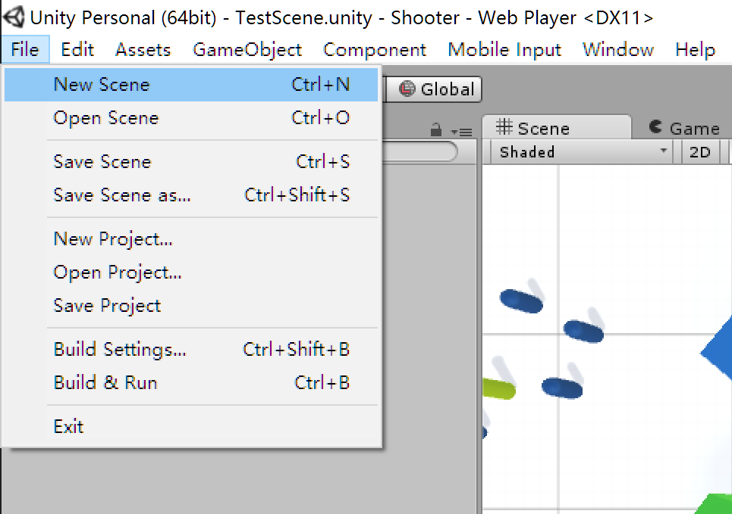
New scene

Slide 4
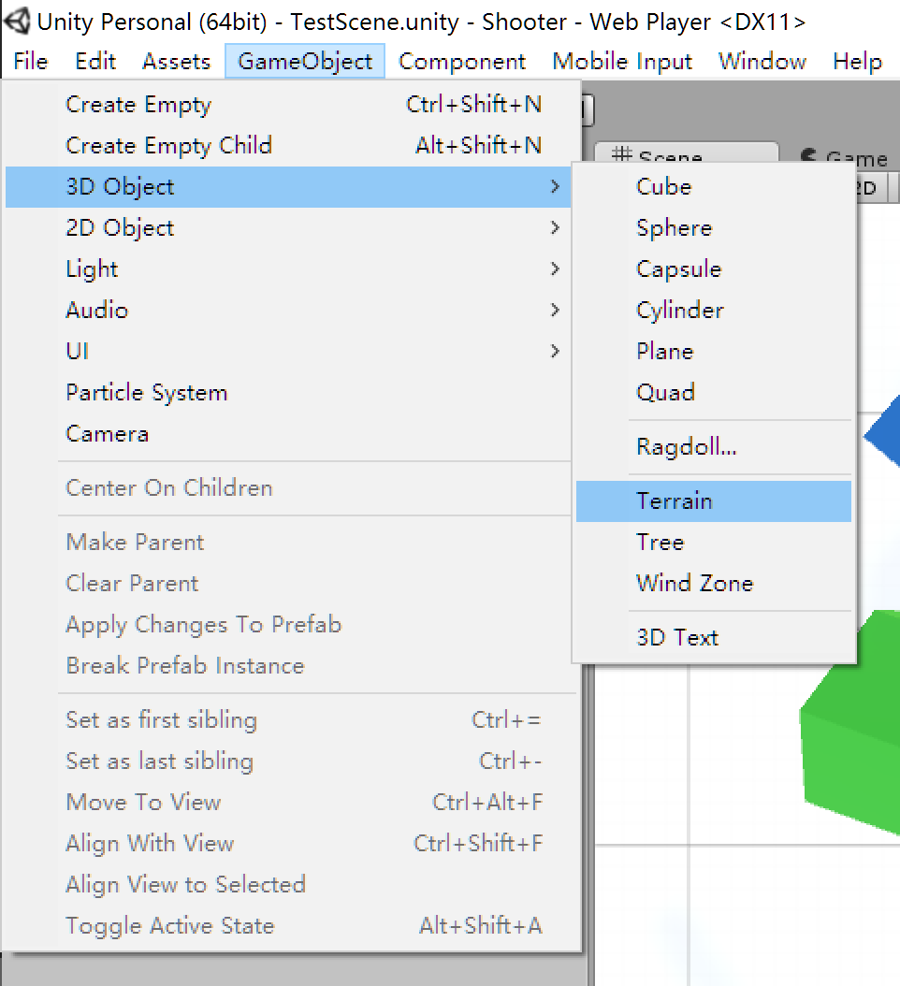
Add terrain

Slide 5
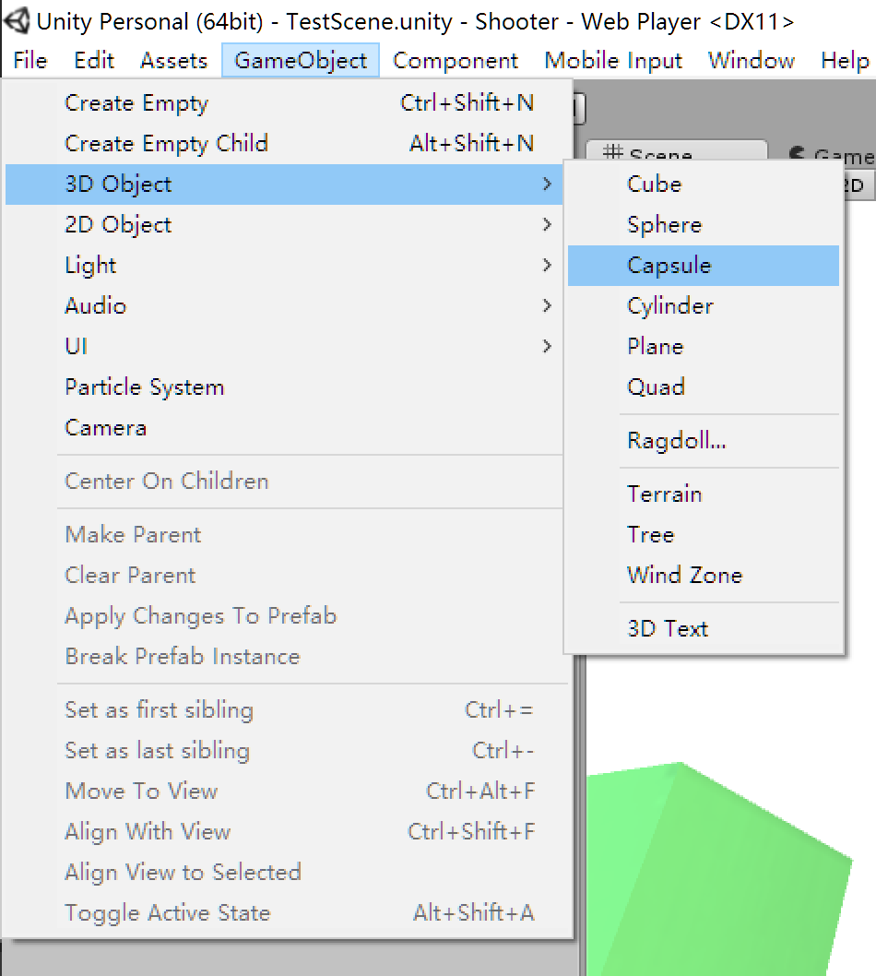
And other game objects

Slide 6
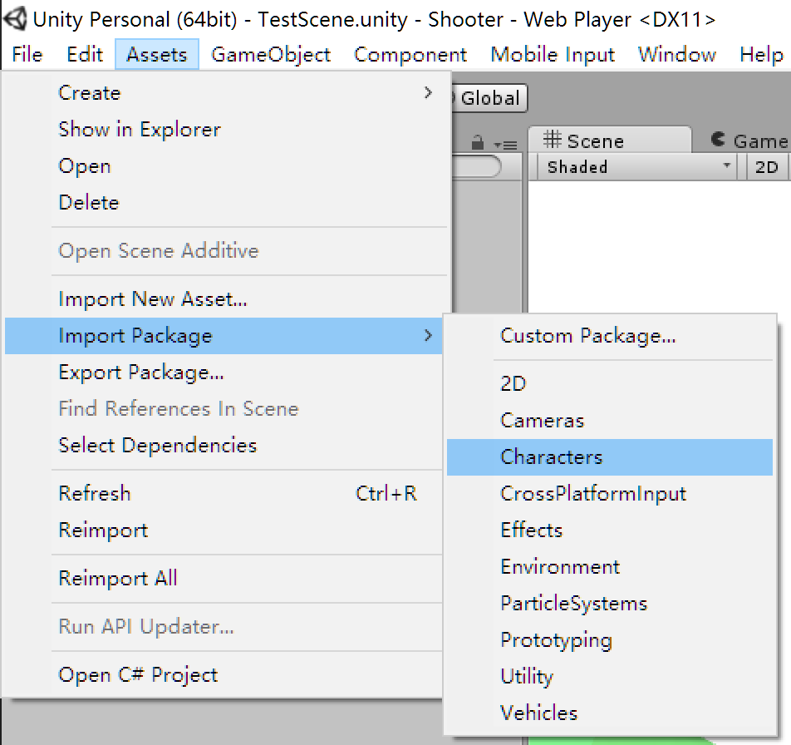
Drag a 3rd person controller into the scene

Slide 7
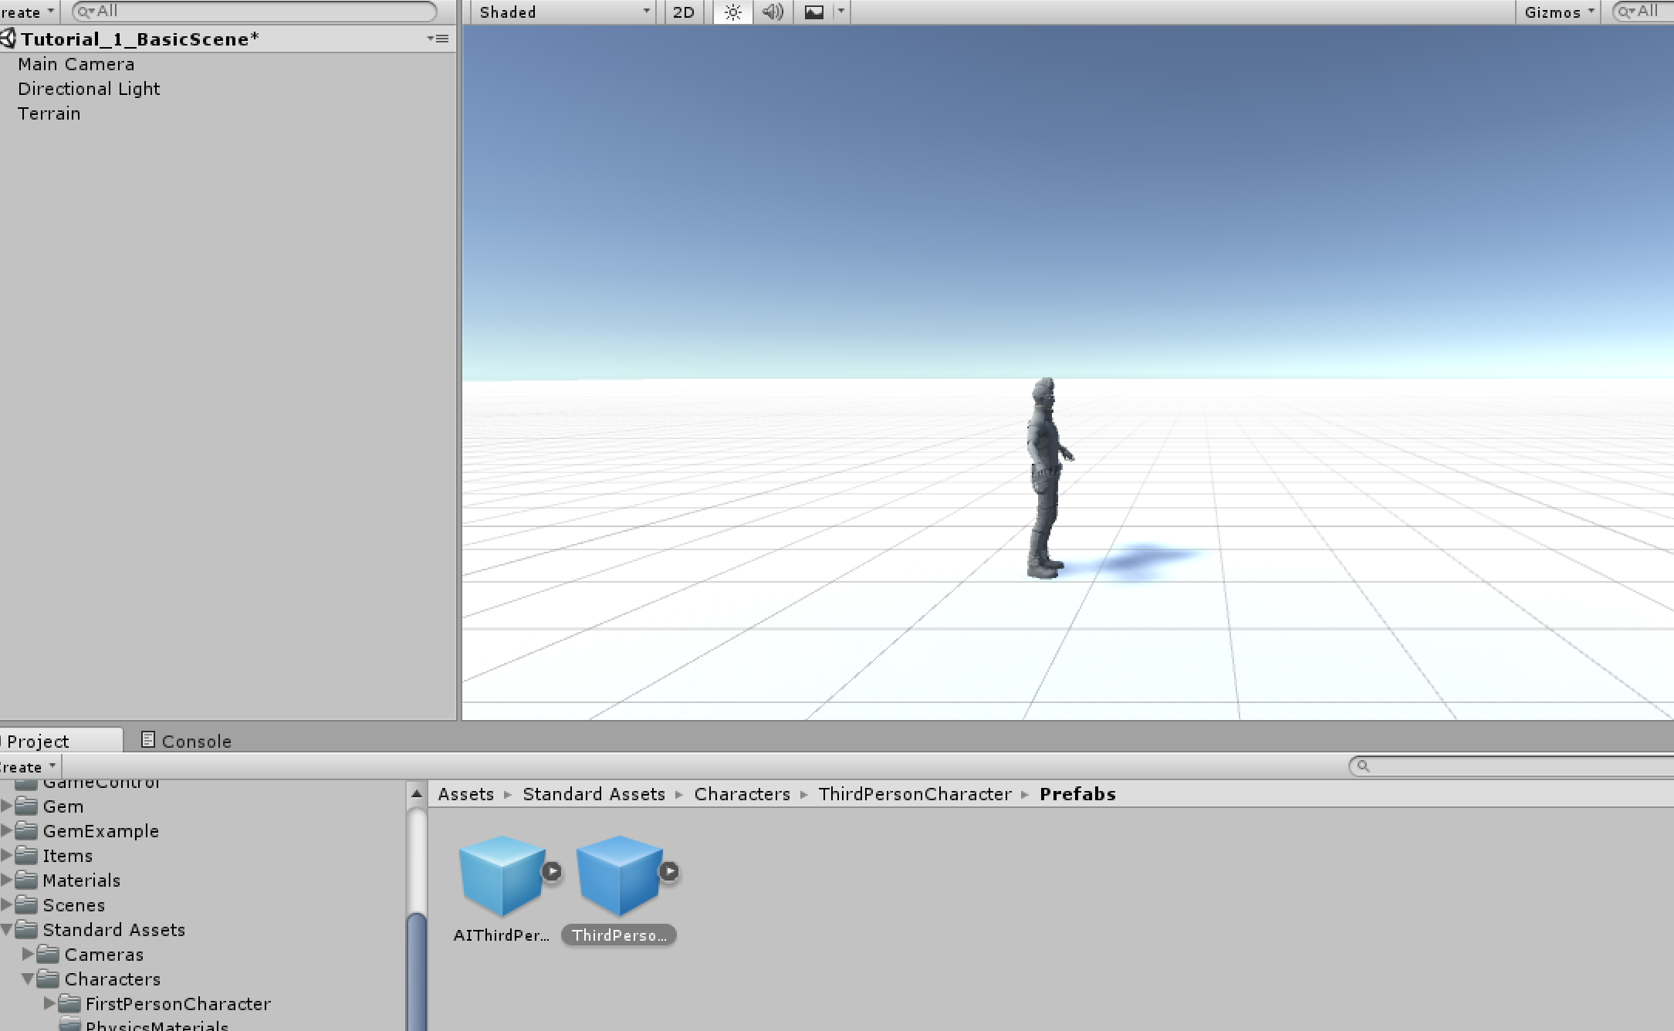

Slide 8
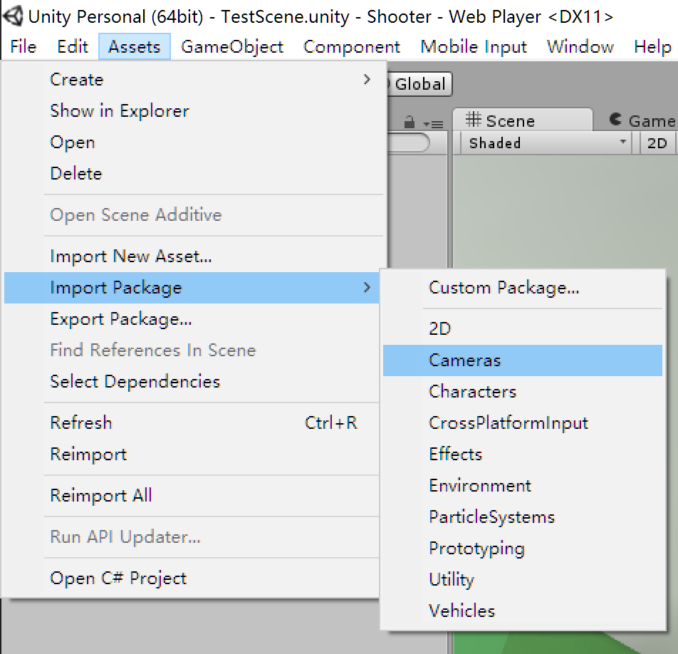
Configure a proper camera

Slide 9
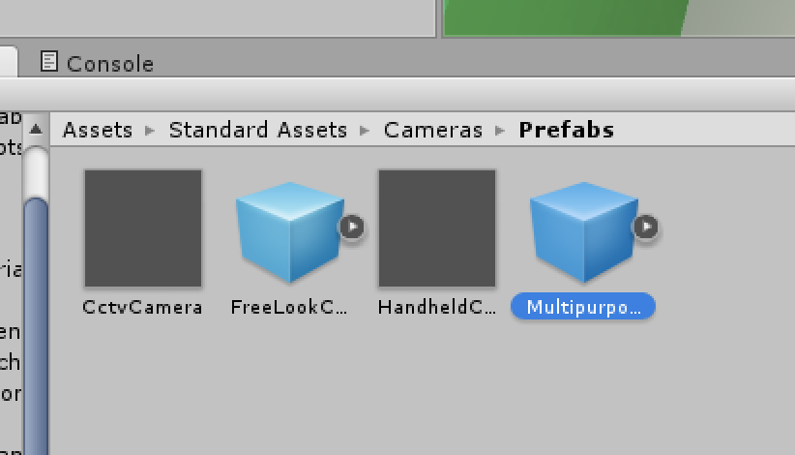

Slide 10
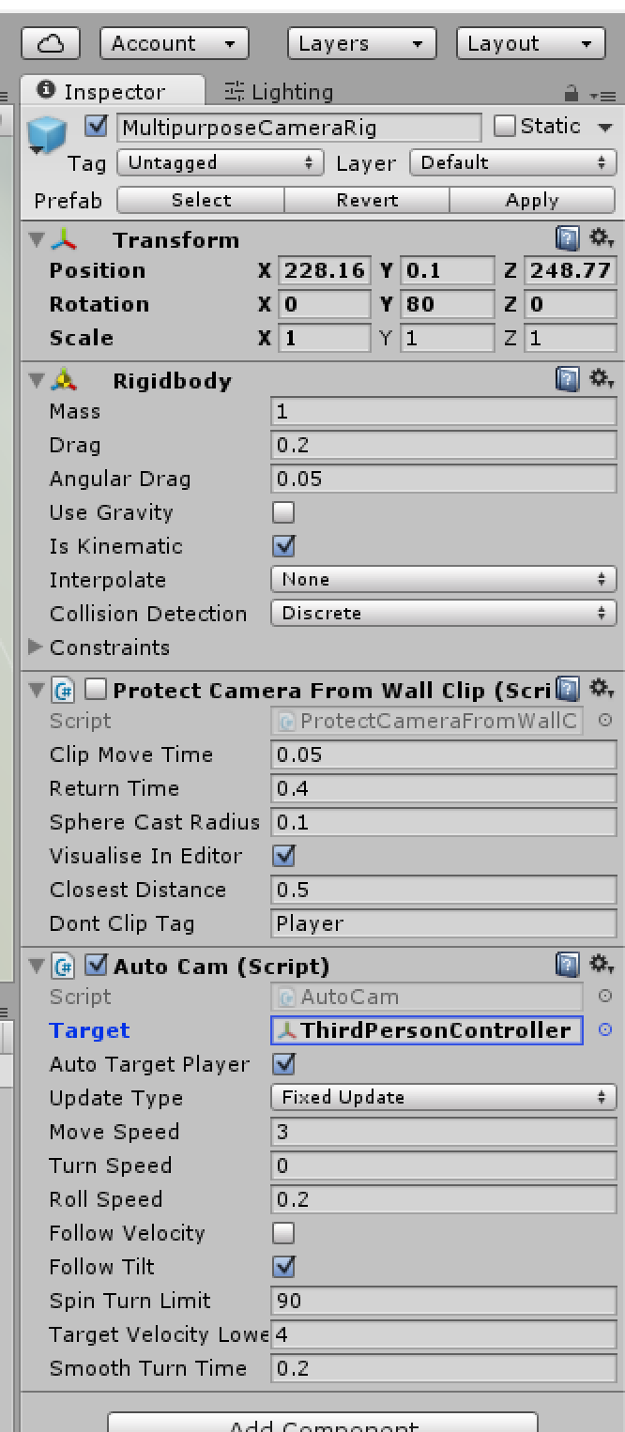
Setting proper camera parameters

Slide 11
Mecanim

Slide 12
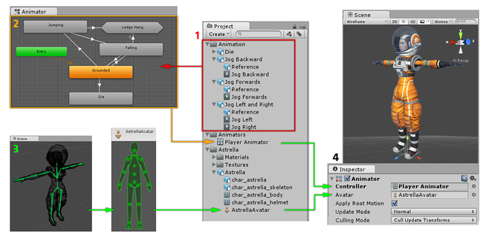
Animation clips are imported from an external source or created within Unity.
The animation clips are placed and arranged in an Animator Controller.
The rigged character model has a specific configuration of bones which are mapped to Unity’s common Avatar format.
When animating the character model, it has an Animator component attached

Slide 13
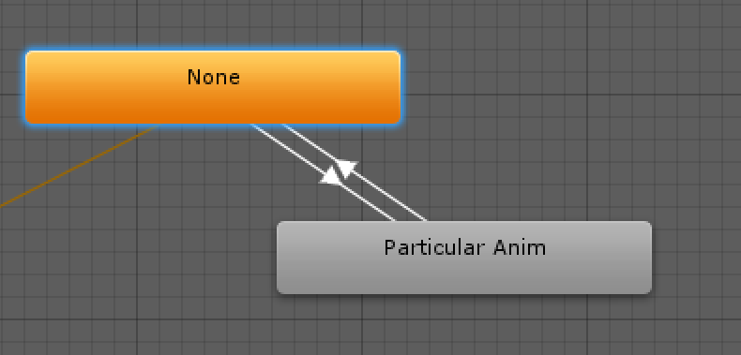
Animation Transitions

Slide 14
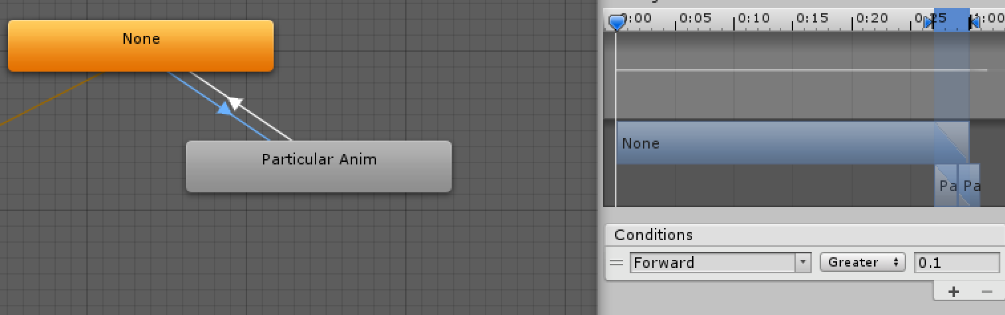

Slide 15
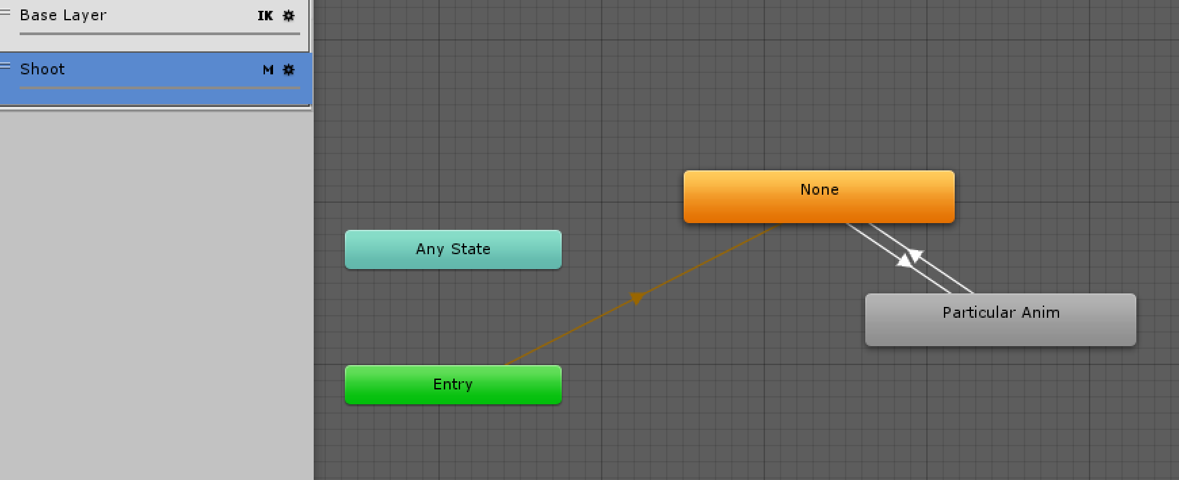
Using multi-layer animation

Slide 16
Mask
The Mask property is there to specify the mask used on this layer
For example if you wanted to play a throwing animation on just the upper body of your model, while having your character also able to walk, run or stand still at the same time, you would use a mask on the layer which plays the throwing animation where the upper body sections are defined

Slide 17
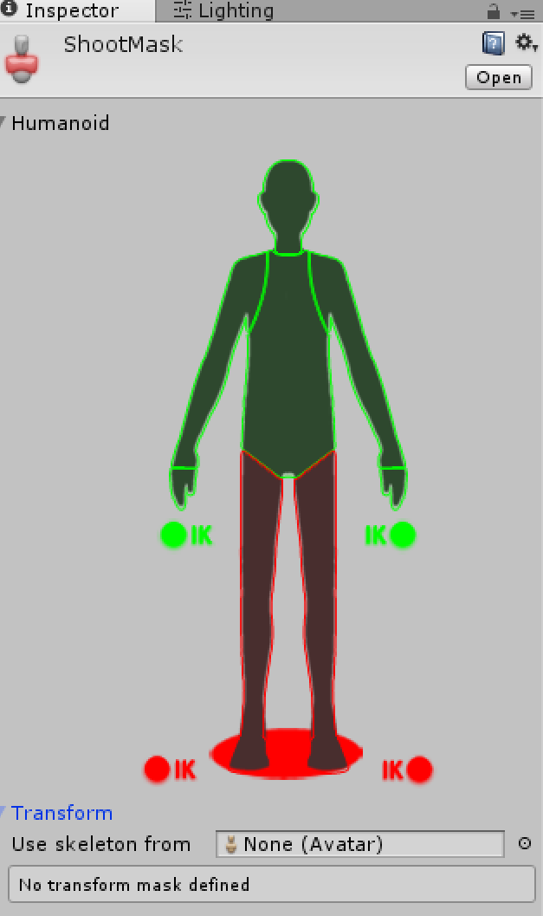

Slide 18
Actor AI

Slide 19
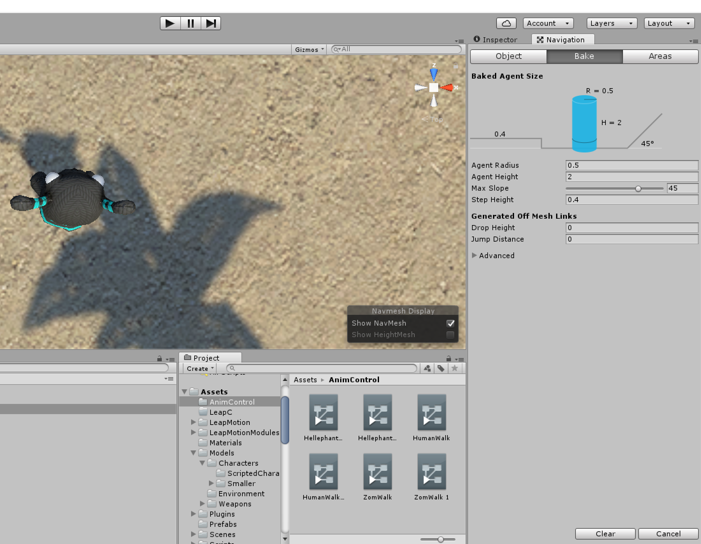
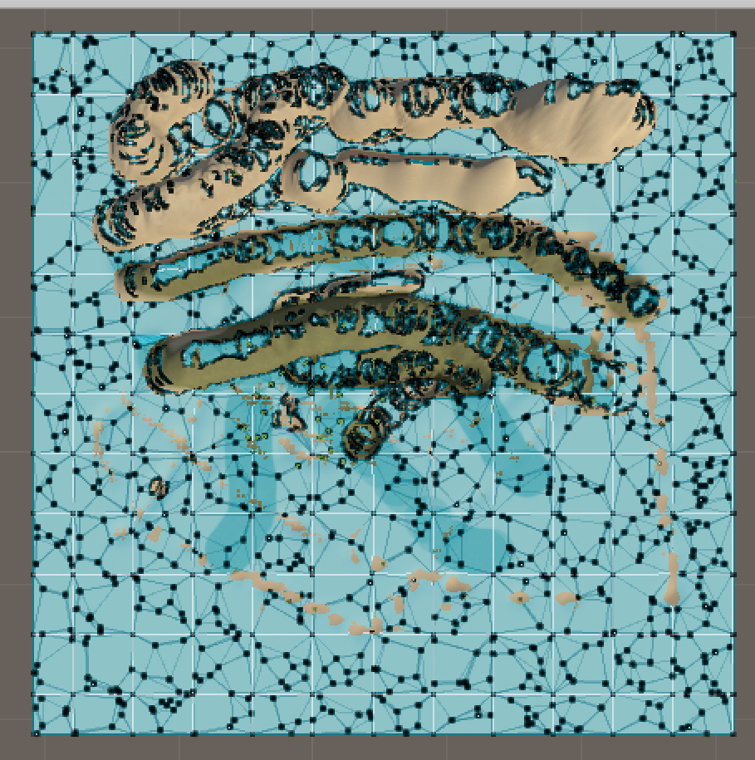
Add AI to enemies, mainly path finding
Bake navigation

Slide 20
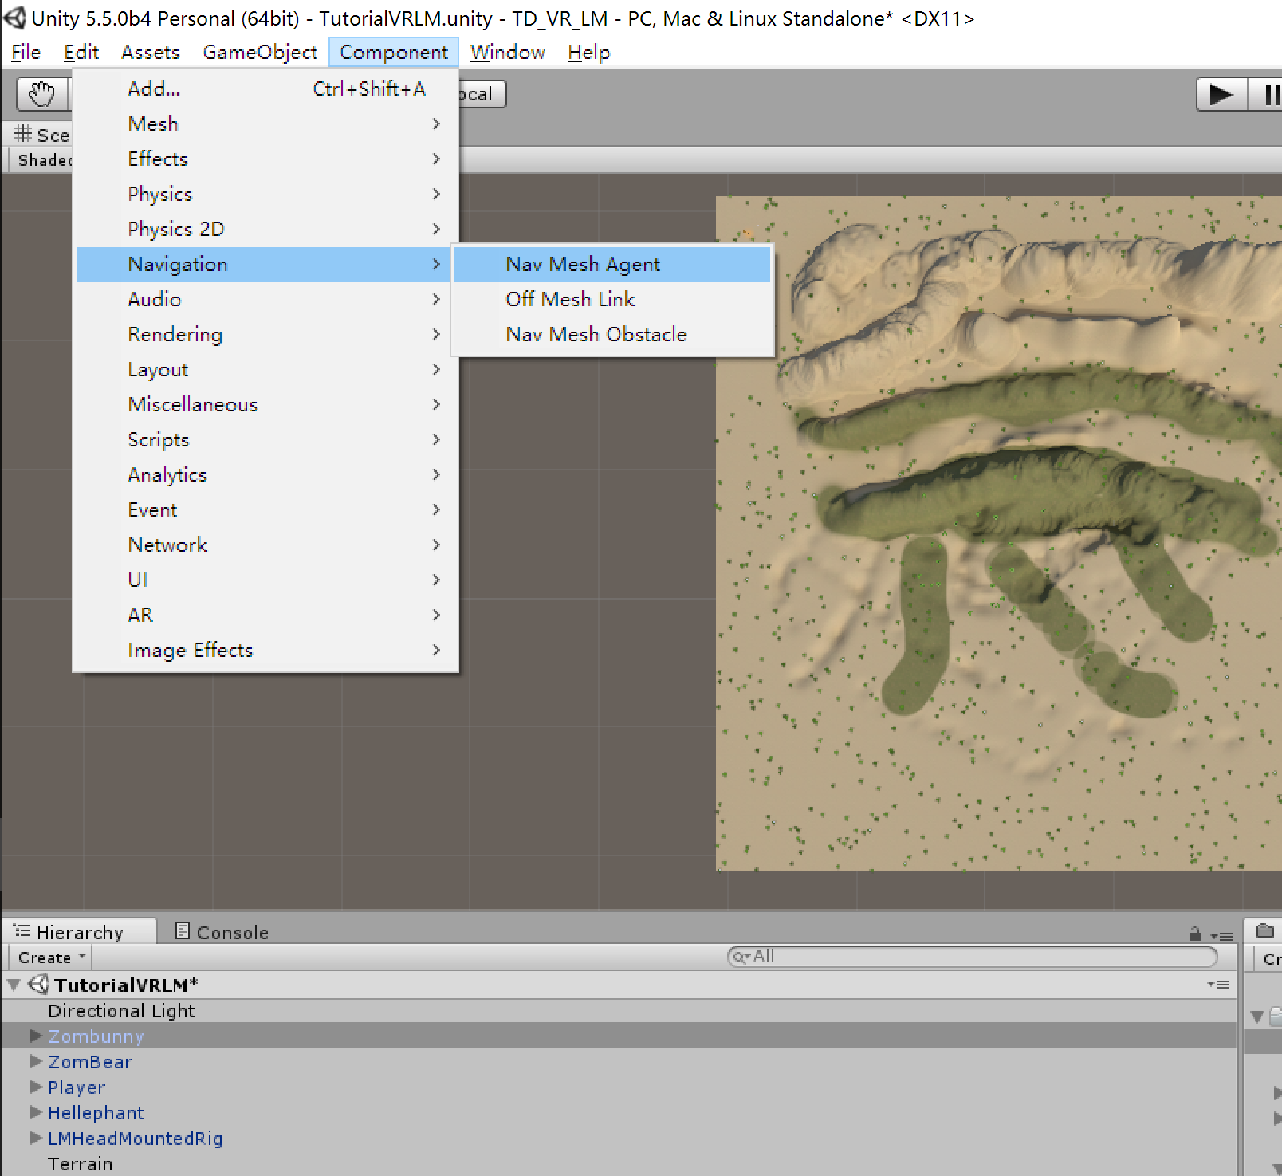
Add NavMeshAgent to AI models

Slide 21
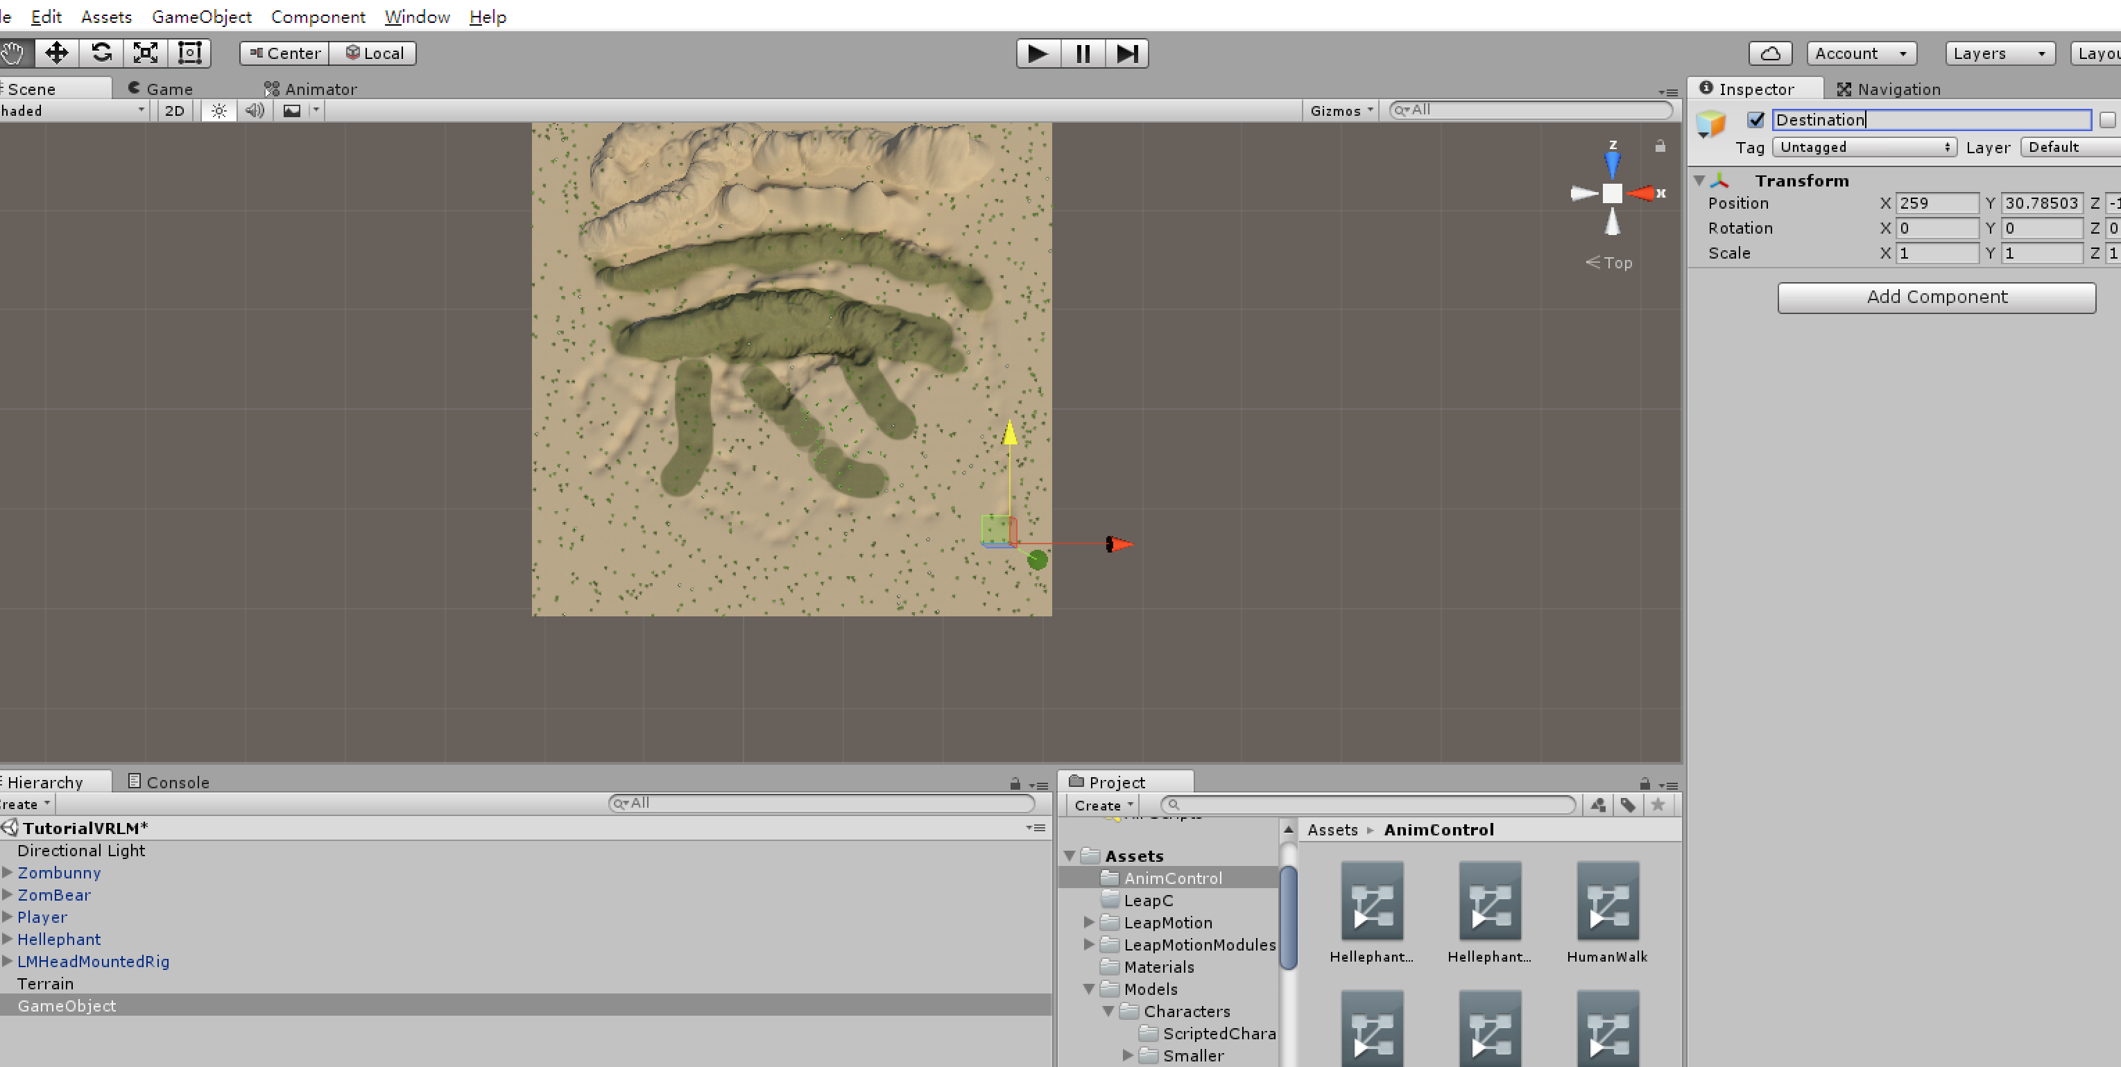
Use script to give them destination

Slide 22
public Transform destPoint;
private NavMeshAgent nav;
void Awake()
{
nav = GetComponent<UnityEngine.AI.NavMeshAgent>();
if (!nav)
return;
Init();
}
public void Init()
{
nav.SetDestination(destPoint.position); // set nav destination
}
Notes:
Bake path finding in Navigation page first.

Slide 23
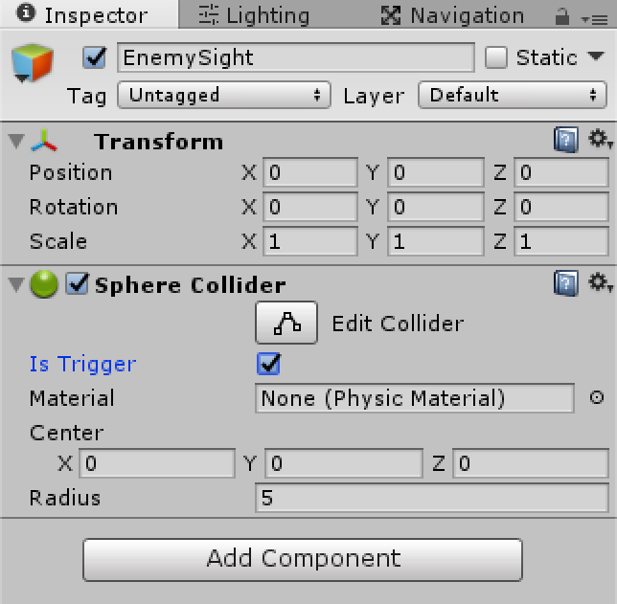
The sight of enemy
Create an empty game object named EnemySight
Add a sphere collider to it, adjust the radius, and set it as Trigger

Slide 24
Set the sight game object as the child of the enemy
Give it a script named EnemySight
The script can judge weather the player is inside the sight of the sphere collider or not
In Enemy script, it will be used as the option if the enemy chase the player or patrol
Notes:
// This is a collider trigger as the child of the enemy
public class EnemySight : MonoBehaviour
{
public float fieldOfViewAngle = 110f; // Number of degrees, centred on forward, for the enemy see.
public bool playerInSight; // Whether or not the player is currently sighted.
public Vector3 personalLastSighting; // Last place this enemy spotted the player.
public static Vector3 resetPos = Vector3.back;
private GameObject player; // Reference to the player.
void Awake()
{
player = GameObject.FindGameObjectWithTag("Player"/*Tags.player*/);
// Set the personal sighting and the previous sighting to the reset position.
personalLastSighting = resetPos;
}
void OnTriggerStay(Collider other)
{
// If the player has entered the trigger sphere...
if (other.gameObject == player)
{
// By default the player is not in sight.
playerInSight = false;
// Create a vector from the enemy to the player and store the angle between it and forward.
Vector3 direction = other.transform.position - transform.position;
float angle = Vector3.Angle(direction, transform.forward);
// If the angle between forward and where the player is, is less than half the angle of view...
if (angle < fieldOfViewAngle * 0.5f)
{
RaycastHit hit;
// ... and if a raycast towards the player hits something...
if (Physics.Raycast(transform.position + transform.up, direction.normalized, out hit, col.radius))
{
// ... and if the raycast hits the player...
if (hit.collider.gameObject == player)
{
// ... the player is in sight.
playerInSight = true;
// Set the last global sighting is the players current position.
//lastPlayerSighting.position = player.transform.position;
personalLastSighting = player.transform.position;
}
}
}
}
}
void OnTriggerExit(Collider other)
{
// If the player leaves the trigger zone...
if (other.gameObject == player)
// ... the player is not in sight.
playerInSight = false;
}
}

Slide 25
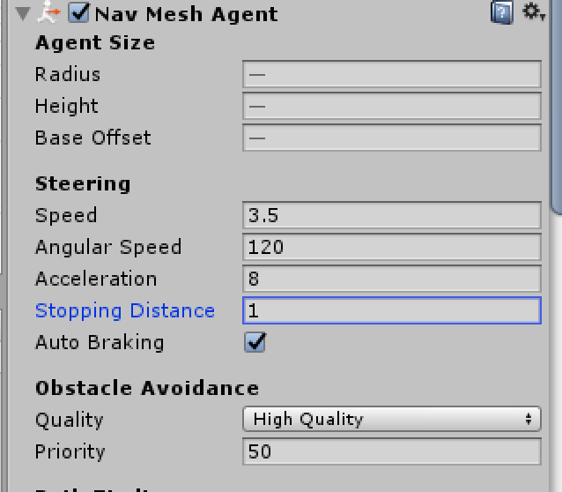
Patrol
In enemy behavior script, use enemysight to control the enemy patrol status
Set stopping distance to a acceptable value
Notes:
using System.Collections;
using System.Collections.Generic;
using UnityEngine;
public class EnemyPatrol : MonoBehaviour
{
public float patrolSpeed = 2f; // The nav mesh agent's speed when patrolling.
public float chaseSpeed = 5f; // The nav mesh agent's speed when chasing.
public float chaseWaitTime = 5f; // The amount of time to wait when the last sighting is reached.
public float patrolWaitTime = 1f; // The amount of time to wait when the patrol way point is reached.
public Transform patrolWayPoints; // An array of transforms for the patrol route.
public float shootRotSpeed = 5f; // Turning speed when aiming at something
public GameObject disappearEffect = null;
public float effectDurationTime = 1f;
private EnemySight enemySight; // Reference to the EnemySight script.
private UnityEngine.AI.NavMeshAgent nav; // Reference to the nav mesh agent.
private float chaseTimer; // A timer for the chaseWaitTime.
private float patrolTimer; // A timer for the patrolWaitTime.
private int wayPointIndex = 0; // A counter for the way point array.
private bool chase = false; //
void Awake()
{
// Get the enemy sight among the children
enemySight = transform.Find("EnemySight").GetComponent<EnemySight>();
Debug.Assert(enemySight);
nav = GetComponent<UnityEngine.AI.NavMeshAgent>();
}
void Update()
{
// If the player is in sight and is alive...
if (enemySight.playerInSight)
// ... shoot.
{
Shooting();
chase = true;
}
// If the player has been sighted and isn't dead...
else if (chase)
// ... chase.
Chasing();
// Otherwise...
else
// ... patrol.
{
Patrolling();
//Debug.Log("Patrol!");
}
}
void Shooting()
{
// Implement shooting function
}
void Chasing()
{
//Debug.Log("Chasing");
nav.Resume();
// Create a vector from the enemy to the last sighting of the player.
Vector3 sightingDeltaPos = enemySight.personalLastSighting - transform.position;
// If the the last personal sighting of the player is not close...
if (sightingDeltaPos.sqrMagnitude > 4f)
// ... set the destination for the NavMeshAgent to the last personal sighting of the player.
nav.destination = enemySight.personalLastSighting;
// Set the appropriate speed for the NavMeshAgent.
nav.speed = chaseSpeed;
// If near the last personal sighting...
if (nav.remainingDistance < nav.stoppingDistance)
{
// ... increment the timer.
chaseTimer += Time.deltaTime;
// If the timer exceeds the wait time...
if (chaseTimer >= chaseWaitTime)
{
// ... reset last global sighting, the last personal sighting and the timer.
//lastPlayerSighting.position = lastPlayerSighting.resetPosition;
chase = false;
chaseTimer = 0f;
}
}
else
// If not near the last sighting personal sighting of the player, reset the timer.
chaseTimer = 0f;
}
void Patrolling()
{
nav.Resume();
// Set an appropriate speed for the NavMeshAgent.
nav.speed = patrolSpeed;
// If near the next waypoint or there is no destination...
if (nav.remainingDistance < nav.stoppingDistance)
{
// ... increment the timer.
patrolTimer += Time.deltaTime;
// If the timer exceeds the wait time...
if (patrolTimer >= patrolWaitTime)
{
// ... increment the wayPointIndex.
if (wayPointIndex == patrolWayPoints.childCount - 1)
wayPointIndex = 0;
else
wayPointIndex++;
// Reset the timer.
patrolTimer = 0;
}
}
else
// If not near a destination, reset the timer.
patrolTimer = 0;
// Set the destination to the patrolWayPoint.
nav.destination = patrolWayPoints.GetChild(wayPointIndex).position;
}
}

Slide 26
Weapon

Slide 27
Weapon constitution
Gun + bullet
Gun: shoot frequency, ammo, fire direction
Bullet: damage, speed, damage type
Player to control it
Player script to handle weapon change, fire, pick up items

Slide 28
Weapon
public void Fire(Vector3 target)
{
if (lastShootTime < freezeTime)
return;
Vector3 dir = target - bulletPos.position;
Vector3 xyProject = Vector3.ProjectOnPlane(dir, Vector3.up);
if (num <= 0)
return;
Vector3 bulletStartPos = bulletPos.position;
bulletStartPos.y = 1;
GameObject g = (GameObject)GameObject.Instantiate(bullet, bulletStartPos, Quaternion.FromToRotation(Vector3.forward, xyProject.normalized));
num--;
lastShootTime = 0f;
}
Notes:
public GameObject bullet = null;
public Transform bulletPos = null;
public float freezeTime = 1f;
private float lastShootTime = 0f;
public int num = 10;
// Use this for initialization
void Start()
{
lastShootTime = freezeTime;
StopFire();
}
// Update is called once per frame
void Update()
{
if (lastShootTime < freezeTime)
{
lastShootTime += Time.deltaTime;
}
}
public void Fire(Vector3 target)
{
if (lastShootTime < freezeTime)
return;
Vector3 dir = target - bulletPos.position;
Vector3 xyProject = Vector3.ProjectOnPlane(dir, Vector3.up);
if (num <= 0)
return;
Vector3 bulletStartPos = bulletPos.position;
bulletStartPos.y = 1;
GameObject g = (GameObject)GameObject.Instantiate(bullet, bulletStartPos, Quaternion.FromToRotation(Vector3.forward, xyProject.normalized));
num--;
lastShootTime = 0f;
}

Slide 29
Bullet
public void Update()
{
if (bMove)
rb.MovePosition(transform.position + transform.forward * speed * Time.deltaTime);
}
public void OnTriggerEnter(Collider other)
{
switch (other.tag)
{
case Tags.obstacle:
bMove = false;
break;
case Tags.enemy:
break;
default:
return;
}
BeginDamage(other);
}
Notes:
public void Update()
{
if (bMove)
rb.MovePosition(transform.position + transform.forward * speed * Time.deltaTime);
}
public void OnTriggerEnter(Collider other)
{
switch (other.tag)
{
case Tags.obstacle:
bMove = false;
break;
case Tags.enemy:
break;
default:
return;
}
BeginDamage(other);
}
private void BeginDamage(Collider other)
{
GetComponent<Renderer>().enabled = false;
EnemyTutorial otherActor = other.GetComponent<EnemyTutorial>();
if (otherActor)
otherActor.Damage(damage);
GameObject.Destroy(gameObject);
}

Slide 30
Grab a gun
void Start()
{
if (!weaponPos)
weaponPos = gameObject.transform;
for (int i = 0; i < weapons.Length; i++)
{
weapons[i] = (GameObject)Instantiate(weapons[i], weaponPos.position, Quaternion.identity);
if (gameObject.tag == Tags.enemy)
weapons[i].SendMessage("SetAsEnemy", true);
weapons[i].transform.SetParent(weaponPos);
//weapons[i].SendMessage("SetUsable", i == currWeapon);
weapons[i].gameObject.SetActive(i == currWeapon);
}
}
Notes:
public Transform weaponPos = null;
public GameObject[] weapons;
public int currWeapon = 0;
protected Vector3 desPos;
// Use this for initialization
void Start()
{
if (!weaponPos)
weaponPos = gameObject.transform;
for (int i = 0; i < weapons.Length; i++)
{
weapons[i] = (GameObject)Instantiate(weapons[i], weaponPos.position, Quaternion.identity);
if (gameObject.tag == Tags.enemy)
weapons[i].SendMessage("SetAsEnemy", true);
weapons[i].transform.SetParent(weaponPos);
//weapons[i].SendMessage("SetUsable", i == currWeapon);
weapons[i].gameObject.SetActive(i == currWeapon);
}
}
public void Fire(Vector3 target)
{
if (weapons.Length > 0)
{
weapons[currWeapon].SendMessage("Fire", target);
}
}
public void StopFire()
{
if (weapons.Length > 0)
{
weapons[currWeapon].SendMessage("StopFire");
}
}
// Update is called once per frame
void Update()
{
if (Input.GetButton("Fire1"))
{
Ray ray = Camera.main.ScreenPointToRay(Input.mousePosition);
float enter = 0.0f;
Plane firePlane = new Plane(Vector3.up, weaponPos.position);
if (firePlane.Raycast(ray, out enter))
{
desPos = ray.GetPoint(enter);
}
Fire(desPos);
}
if (Input.GetButtonUp("Fire1"))
{
StopFire();
}
// change weapon
float f = Input.GetAxis("Mouse ScrollWheel");
if (f > 0)
NextWeapon(1);
else if (f < 0)
NextWeapon(-1);
}
protected void Die()
{
gameObject.SetActive(false);
Application.Quit();
}
bool NextWeapon(int next)
{
weapons[currWeapon].gameObject.SetActive(false);
currWeapon = Mathf.Abs(currWeapon + next + weapons.Length) % weapons.Length;
weapons[currWeapon].gameObject.SetActive(true);
StopFire(); // stop fire when changing to a new weapon
return true;
}
bool ChangeWeapon(int idx)
{
weapons[currWeapon].gameObject.SetActive(false);
weapons[idx].gameObject.SetActive(true);
currWeapon = idx;
//Debug.Log("Changed Weapon");
return true;
}

Slide 31
Calculate fire direction
if (Input.GetButton("Fire1"))
{
Ray ray = Camera.main.ScreenPointToRay(Input.mousePosition);
float enter = 0.0f;
Plane firePlane = new Plane(Vector3.up, weaponPos.position);
if (firePlane.Raycast(ray, out enter))
{
desPos = ray.GetPoint(enter);
}
Fire(desPos);
}

Slide 32
Change weapon
bool NextWeapon(int next)
{
weapons[currWeapon].gameObject.SetActive(false);
currWeapon = Mathf.Abs(currWeapon + next + weapons.Length) % weapons.Length;
weapons[currWeapon].gameObject.SetActive(true);
StopFire(); // stop fire when changing to a new weapon
return true;
}

Slide 33
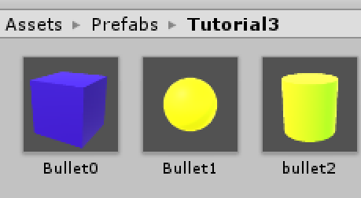
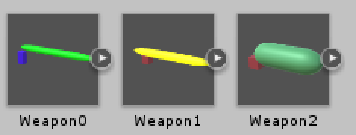

Slide 34
